Slide 1
Tree Based Models

Slide 2

Tree Based Models Tested
Decision Tree
Tuned Decision Tree
Bagged Tree
Random Forest
Tuned Random Forest
Stochastic Gradient Boost

Slide 3
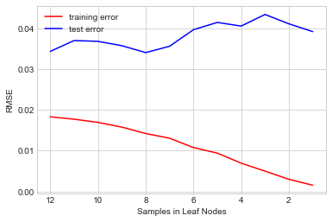
Decision Tree vs. Tuned Decision Tree
Decision Tree
Tuned Decision Tree
Tuning Samples in Leaf Nodes with GridSearch
Parameters:
EVERYTHING defaulted
R²
Training: 99%
Test: 74%
RMSE
Training: ~ 0
Test: .2195
Best Parameters
Max Depth: 11
Min Samples Leaf: 8
R²
Training: 91%
Test: 77%
RMSE
Training: .1146
Test: .1861
THOUGHTS: We have only fit the tree on one set of observations. Lower the variance by fitting the tree on MULTIPLE sets of observations using a Bagged Decision Tree.

Slide 4
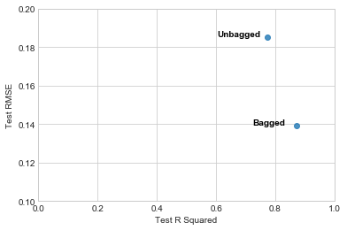
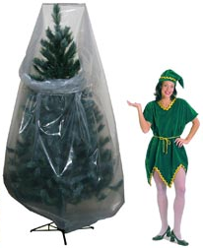
Bagged Tree Continues To Improve Score
Improvement with Bagged Tree
Parameters
Trees: 500
Max Samples: 783
(2/3rds of training set)
R²
Training: 97%
OOB: 87%
Test: 88%
RMSE
Training: .0745
Test: .1370
THOUGHTS: Training and Test scores were improved but trees are too correlated as we are using the same set of parameters. Take subset of predictors at each split to decorrelate the trees using Random Forest.

Slide 5
Bagged Tree vs. Random Forest. No Change?!
Bagged Tree
Random Forest
Parameters
Trees: 500
Max Samples: 783 (2/3rs of training)
R²
Training: 97%
OOB: 87%
Test: 88%
RMSE
Training: .0745
Test: .1370
Parameters
Trees: 500
Max features: 17 ( sqrt(p) )
R²
Training: 98%
OOB: 86%
Test: 88%
RMSE
Training: .0538
Test: .1339
THOUGHTS: Things barely changed (.003 improvement in Test RMSE) in the results between the Bagged Tree and the Random Forest model. But what DID change were the importance to each predictor.

Slide 6
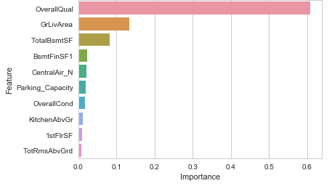
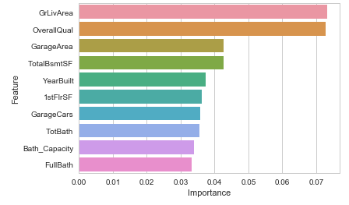
Top 10 Variable Importance Comparison
Correlated Trees (Bagged Tree)
Non Correlated Trees (Random Forest)

Slide 7
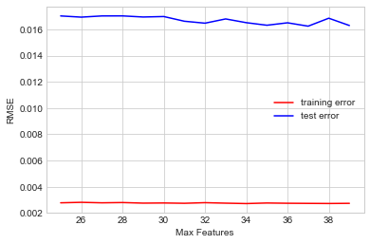
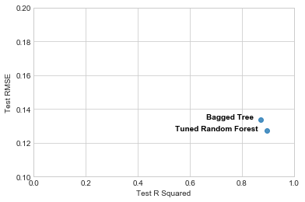
Tuned Random Forest – No Huge Improvements
Best Parameters
Trees: 500
Max Features: 37
R²
Training: 98%
OOB: 87%
Test: 89%
RMSE
Training: .0526
Test: .1274
Tuning Max Features with GridSearch
Improvement with Tuned Random Forest
THOUGHTS: Again, not much changed for the Training and Test R² . A .003 improvement in Test RMSE. What’s going on?

Slide 8
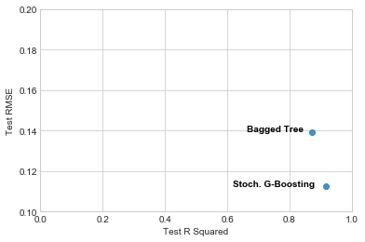
Stochastic Gradient Boosting Shows Considerable Improvement To Score
Parameters
Learning Rate: 0.1
Subsample: 2/3
Depth: 3
R²
Training: 96%
Test: 92%
RMSE
Training: .0835
Test: .1125
Improvement with Stoch. G-Boosting
Test R² : 88% -> 92%
Test RMSE : .1361 -> .1125

Slide 9
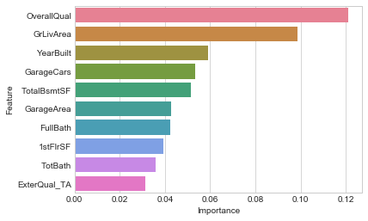
Tuned Stochastic Gradient Boosting (using GridSearchCV)
Final Top 10 Important Variables
Best Parameters
Trees: 650
Learning Rate: 0.05
Subsample = 2/3
R²
Training: 99%
Test: 93%
RMSE
Training: .0454
Test: .1036

Slide 10
Tree Based Model Comparison

